Slide 1
Pengaruh Model Pembelajaran Menggunakan IndoBlockly (Bahasa Pemrograman Visual Block) terhadap Pemahaman Mahasiswa pada Matakuliah Pemrograman Terstruktur (Studi pada Mahasiswa Semester I Angkatan 2012/2013 Teknik Informatika UIN Sunan Kalijaga Yogyakarta)
Rischan Mafrur
http://www.developers.or.id

Slide 2



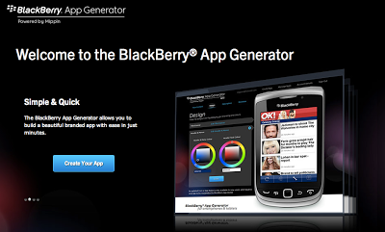

Introduction

Slide 3
goal
indoblockly can improve learning outcomes ?
TRUE || FALSE

Slide 4
benefit
For IndoBlockly developers?
For Reseacher (me) ?
For User (student and everyone) ?
For next research ?

Slide 5
references()
Robins,2003 : two factor => from himself, from teaching strategies.
Lahtinen,2005 : types of programming languages => important factor for novice programmer.
Kelleher dan Pausch,2003 : programming environment taxonomy => highest taxonomy is teaching system. Technical and social problems about novice programmer.
Scratch paper by Maloney, 2008 : scratch club house ☺ scratch.mit.edu , full support by Massachusetts Institute of Technology

Slide 6
basic theory
About learning and learning programming
Why programming is so difficult?
VPLs is better solution?
Advantages and disadvantages about VPLs.
IndoBlockly

Slide 7
Uji coba instrumen penelitian
Population and sample (purposive sampling).
Uji coba instrumen penelitian => Uji instrumen expert, dan Analisis hasil uji coba. (validitas, reliabilitas, daya beda, tingkat kesukaran).
10 instrumen soal dan yang dipakai untuk penelitian ada 7 soal.
Lampiran B Analisis Uji Instrumen

Slide 8


experiment
Pretest
⬇
Learning Process with different treatment
⬅
➔
Experiment class
Control class
⬇
Postest

Slide 9
discussion
Analisis Deskriptif
Analisis Index Gain
Analisis Statistik Inferensi

Slide 10
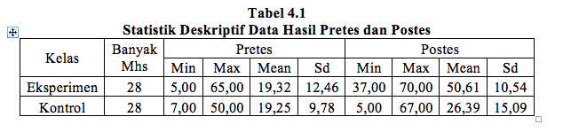
Analisis Deskriptif

Slide 11
Analisis Inferensi
Data Pretes Eksperimen dan Kontrol
Normalitas Data Pretes => Shapiro Wilk (Tidak Berdistribusi Normal), p value all < 0,05.
Uji Non Parametrik (Uji kesamaan dua rata-rata dengan Mann Whitney) => tidak terdapat perbedaan rata-rata, p-value 0,749 > 0,05.

Slide 12
Conn…
Data Postest Experimen dan Kontrol
Normalitas => Shapiro Wilk, p-value all < 0.05 : Tidak Normal
Mann Whitney (Kesamaan Rata-rata), p-value < 0.05. Ada Perbedaan Rata-Rata Postes Kelas Experimen dan Kontrol.

Slide 13
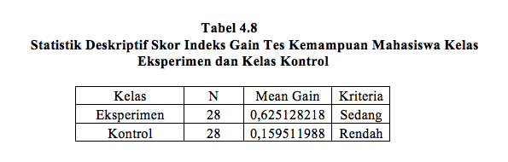
Analisis Index Gain
Lampiran I Perhitungan Index Gain

Slide 14
Analisis Korelasi
Pretes Postes Kelas Eksperimen
Normalitas pretes dan postes eksperimen p-value < 0.05. Tidak Berdistribusi Normal
Uji Korelasi (Spearman)
Sebelumnya Uji Hipotesis Korelasi, p-value 0,00 < 0.05=> Ada Korelasi.
Hitung Koefisien korelasi (r) dengan spearman 0,43
Uji Signifikansi koefisien korelasi, p-value 0,02 < 0.05 => signifikan.
Determinasi r² = 0.1849 / 18.49 %

Slide 15
Demo IndoBlockly & statistik R tool

